Slide 1

Chapter Twelve
Uncertain Knowledge and Reasoning

Slide 2
Learning objectives.
12.1 Uncertainty
12.2 Basic probability theorem
12.3 Baye’s theorem
12.4 Bayesians belief network
12.5 Temporal model
12.6 Marvok Decision Process
12.7 MDP Formulation
12.8 Partially observable MDP
After this chapter , students will be able to :
Represent the problem in terms of probabilistic statement.
Apply Bayes rule and product rule for inferencing.
Represent problem using Bayes net.
Perform probabilistic inference using Bayes net.
Copyright © 2019 by Wiley India Pvt. Ltd., 4436/7, Ansari Road, Daryaganj, New Delhi-110002

Slide 3
Uncertainty
12.1 Uncertainty
12.2 Basic probability theorem
12.3 Baye’s theorem
12.4 Bayesians belief network
12.5 Temporal model
12.6 Marvok Decision Process
12.7 MDP Formulation
12.8 Partially observable MDP
Uncertainty can be defined as many of the simplifications that are possible with deductive inference are no longer valid.
Uncertainty is unavoidable in everyday reasoning and in many real-world domains.
Sources of uncertainty
Imprecise knowledge: For example, the time that an event happened can be known only approximately.
Unreliable knowledge: For example, a measuring instrument can be biased or defective.
Reasons for uncertainty
Laziness
Theoretical Ignorance
Practical Ignorance
Copyright © 2019 by Wiley India Pvt. Ltd., 4436/7, Ansari Road, Daryaganj, New Delhi-110002

Slide 4
1. Probability theory
12.1 Uncertainty
12.2 Basic probability theorem
12.3 Baye’s theorem
12.4 Bayesians belief network
12.5 Temporal model
12.6 Marvok Decision Process
12.7 MDP Formulation
12.8 Partially observable MDP
1.1 Uncertain knowledge
∀p symptom(p, Toothache) → disease(p,cavity)
∀p sympt(p,Toothache) →
disease(p,cavity) ∨ disease(p,gum_disease) ∨…
PL
- laziness
- theoretical ignorance
- practical ignorance
Probability theory ➔ degree of belief or plausibility of a statement – a numerical measure in [0,1]
Degree of truth – fuzzy logic ≠ degree of belief
4
Copyright © 2019 by Wiley India Pvt. Ltd., 4436/7, Ansari Road, Daryaganj, New Delhi-110002

Slide 5
1.2 Definitions
12.1 Uncertainty
12.2 Basic probability theorem
12.3 Baye’s theorem
12.4 Bayesians belief network
12.5 Temporal model
12.6 Marvok Decision Process
12.7 MDP Formulation
12.8 Partially observable MDP
Unconditional or prior probability of A – the degree of belief in A in the absence of any other information – P(A)
A – random variable
Probability distribution – P(A), P(A,B)
Example
P(Weather = Sunny) = 0.1
P(Weather = Rain) = 0.7
P(Weather = Snow) = 0.2
Weather – random variable
P(Weather) = (0.1, 0.7, 0.2) – probability dsitribution
Conditional probability – posterior – once the agent has obtained some evidence B for A - P(A|B)
P(Cavity | Toothache) = 0.8
5
Copyright © 2019 by Wiley India Pvt. Ltd., 4436/7, Ansari Road, Daryaganj, New Delhi-110002

Slide 6
Definitions - cont
12.1 Uncertainty
12.2 Basic probability theorem
12.3 Baye’s theorem
12.4 Bayesians belief network
12.5 Temporal model
12.6 Marvok Decision Process
12.7 MDP Formulation
12.8 Partially observable MDP
Axioms of probability
The measure of the occurrence of an event (random variable) A – a function P:S → R satisfying the axioms:
0 ≤ P(A) ≤ 1
P(S) = 1 ( or P(true) = 1 and P(false) = 0)
P(A ∨ B) = P(A) + P(B) - P(A ∧ B)
P(A ∨ ~A) = P(A)+P(~A) –P(false) = P(true)
P(~A) = 1 – P(A)
6
Copyright © 2019 by Wiley India Pvt. Ltd., 4436/7, Ansari Road, Daryaganj, New Delhi-110002

Slide 7
Definitions - cont
12.1 Uncertainty
12.2 Basic probability theorem
12.3 Baye’s theorem
12.4 Bayesians belief network
12.5 Temporal model
12.6 Marvok Decision Process
12.7 MDP Formulation
12.8 Partially observable MDP
A and B mutually exclusive ➔ P(A ∨ B) = P(A) + P(B)
P(e₁ ∨ e₂ ∨ e₃ ∨ … e_{n}) = P(e₁) + P(e₂) + P(e₃) + … + P(e_{n})
The probability of a proposition a is equal to the sum of the probabilities of the atomic events in which a holds
e(a) – the set of atomic events in which a holds
P(a) = Σ P(e_{i})
e_{i}∈e(a)
7
Copyright © 2019 by Wiley India Pvt. Ltd., 4436/7, Ansari Road, Daryaganj, New Delhi-110002

Slide 8
1.3 Product rule
12.1 Uncertainty
12.2 Basic probability theorem
12.3 Baye’s theorem
12.4 Bayesians belief network
12.5 Temporal model
12.6 Marvok Decision Process
12.7 MDP Formulation
12.8 Partially observable MDP
Conditional probabilities can be defined in terms of unconditional probabilities
The condition probability of the occurrence of A if event B occurs
P(A|B) = P(A ∧ B) / P(B)
This can be written also as:
P(A ∧ B) = P(A|B) * P(B)
For probability distributions
P(A=a1 ∧ B=b1) = P(A=a1|B=b1) * P(B=b1)
P(A=a1 ∧ B=b2) = P(A=a1|B=b2) * P(B=b2) ….
P(X,Y) = P(X|Y)*P(Y)
8
Copyright © 2019 by Wiley India Pvt. Ltd., 4436/7, Ansari Road, Daryaganj, New Delhi-110002

Slide 9
Bayes’ rule and its use
12.1 Uncertainty
12.2 Basic probability theorem
12.3 Baye’s theorem
12.4 Bayesians belief network
12.5 Temporal model
12.6 Marvok Decision Process
12.7 MDP Formulation
12.8 Partially observable MDP
P(A ∧ B) = P(A|B) *P(B)
P(A ∧ B) = P(B|A) *P(A)
Bays’ rule (theorem)
P(B|A) = P(A | B) * P(B) / P(A)
P(B|A) = P(A | B) * P(B) / P(A)
Copyright © 2019 by Wiley India Pvt. Ltd., 4436/7, Ansari Road, Daryaganj, New Delhi-110002

Slide 10
Bayes Theorem
12.1 Uncertainty
12.2 Basic probability theorem
12.3 Baye’s theorem
12.4 Bayesians belief network
12.5 Temporal model
12.6 Marvok Decision Process
12.7 MDP Formulation
12.8 Partially observable MDP
h_{i} – hypotheses (i=1,k);
e₁,…,e_{n} - evidence
P(h_{i})
P(h_{i} | e₁,…,e_{n})
P(e₁,…,e_{n}| h_{i})
10
Copyright © 2019 by Wiley India Pvt. Ltd., 4436/7, Ansari Road, Daryaganj, New Delhi-110002

Slide 11
Bayes’ Theorem - cont
12.1 Uncertainty
12.2 Basic probability theorem
12.3 Baye’s theorem
12.4 Bayesians belief network
12.5 Temporal model
12.6 Marvok Decision Process
12.7 MDP Formulation
12.8 Partially observable MDP
If e₁,…,e_{n} are independent hypotheses then
PROSPECTOR
11
Copyright © 2019 by Wiley India Pvt. Ltd., 4436/7, Ansari Road, Daryaganj, New Delhi-110002

Slide 12
Inferences
12.1 Uncertainty
12.2 Basic probability theorem
12.3 Baye’s theorem
12.4 Bayesians belief network
12.5 Temporal model
12.6 Marvok Decision Process
12.7 MDP Formulation
12.8 Partially observable MDP
Probability distribution P(Cavity, Tooth)
Tooth ∼ Tooth
Cavity 0.04 0.06
∼ Cavity 0.01 0.89
P(Cavity) = 0.04 + 0.06 = 0.1
P(Cavity ∨ Tooth) = 0.04 + 0.01 + 0.06 = 0.11
P(Cavity | Tooth) = P(Cavity ∧ Tooth) / P(Tooth) = 0.04 / 0.05
12
Copyright © 2019 by Wiley India Pvt. Ltd., 4436/7, Ansari Road, Daryaganj, New Delhi-110002

Slide 13
Inferences
12.1 Uncertainty
12.2 Basic probability theorem
12.3 Baye’s theorem
12.4 Bayesians belief network
12.5 Temporal model
12.6 Marvok Decision Process
12.7 MDP Formulation
12.8 Partially observable MDP
 | Tooth |  | ~ Tooth
 | Catch | ~ Catch | Catch | ~ Catch
Cavity | 0.108 | 0.012 | 0.072 | 0.008
~ Cavity | 0.016 | 0.064 | 0.144 | 0.576
Probability distributions P(Cavity, Tooth, Catch)
P(Cavity) = 0.108 + 0.012 + 0.72 + 0.008 = 0.2
P(Cavity ∨ Tooth) = 0.108 + 0.012 + 0.072 + 0.008 + 0.016
+ 0.064 = 0.28
P(Cavity | Tooth) = P(Cavity ∧ Tooth) / P(Tooth) =
[P(Cavity ∧ Tooth ∧ Catch) + P(Cavity ∧ Tooth ∧ ~ Catch)] * / P(Tooth)
13
Copyright © 2019 by Wiley India Pvt. Ltd., 4436/7, Ansari Road, Daryaganj, New Delhi-110002

Slide 14
2 Bayesian networks
12.1 Uncertainty
12.2 Basic probability theorem
12.3 Baye’s theorem
12.4 Bayesians belief network
12.5 Temporal model
12.6 Marvok Decision Process
12.7 MDP Formulation
12.8 Partially observable MDP
Represent dependencies among random variables
Give a short specification of conditional probability distribution
Many random variables are conditionally independent
Simplifies computations
Graphical representation
DAG – causal relationships among random variables
Allows inferences based on the network structure
14
Copyright © 2019 by Wiley India Pvt. Ltd., 4436/7, Ansari Road, Daryaganj, New Delhi-110002

Slide 15
2.1 Definition of Bayesian networks
12.1 Uncertainty
12.2 Basic probability theorem
12.3 Baye’s theorem
12.4 Bayesians belief network
12.5 Temporal model
12.6 Marvok Decision Process
12.7 MDP Formulation
12.8 Partially observable MDP
A BN is a DAG in which each node is annotated with quantitative probability information, namely:
Nodes represent random variables (discrete or continuous)
Directed links X→Y: X has a direct influence on Y, X is said to be a parent of Y
each node X has an associated conditional probability table, P(X_{i} | Parents(X_{i})) that quantify the effects of the parents on the node
Example: Weather, Cavity, Toothache, Catch
Weather, Cavity → Toothache, Cavity → Catch
15
Copyright © 2019 by Wiley India Pvt. Ltd., 4436/7, Ansari Road, Daryaganj, New Delhi-110002

Slide 16
Bayesian network - example
12.1 Uncertainty
12.2 Basic probability theorem
12.3 Baye’s theorem
12.4 Bayesians belief network
12.5 Temporal model
12.6 Marvok Decision Process
12.7 MDP Formulation
12.8 Partially observable MDP v
P(B)
0.001
Burglary
P(E)
0.002
Earthquake
B E P(A)
T T 0.95
T F 0.94
F T 0.29
F F 0.001
Alarm
A P(J)
T 0.9
F 0.05
A P(M)
T 0.7
F 0.01
JohnCalls
MaryCalls
B E P(A | B, E)
T F
T T 0.95 0.05
T F 0.94 0.06
F T 0.29 0.71
F F 0.001 0.999
Conditional probability
table
16
Copyright © 2019 by Wiley India Pvt. Ltd., 4436/7, Ansari Road, Daryaganj, New Delhi-110002

Slide 17
2.2 Bayesian network semantics
12.1 Uncertainty
12.2 Basic probability theorem
12.3 Baye’s theorem
12.4 Bayesians belief network
12.5 Temporal model
12.6 Marvok Decision Process
12.7 MDP Formulation
12.8 Partially observable MDP
A) Represent a probability distribution
B) Specify conditional independence – build the network
A) each value of the probability distribution can be computed as:
P(X₁=x₁ ∧ … X_{n}=x_{n}) = P(x₁,…, x_{n}) =
Π_{i=1,n} P(x_{i} | Parents(x_{i}))
where Parents(xi) represent the specific values of Parents(Xi)
17
Copyright © 2019 by Wiley India Pvt. Ltd., 4436/7, Ansari Road, Daryaganj, New Delhi-110002

Slide 18
2.3 Building the network
12.1 Uncertainty
12.2 Basic probability theorem
12.3 Baye’s theorem
12.4 Bayesians belief network
12.5 Temporal model
12.6 Marvok Decision Process
12.7 MDP Formulation
12.8 Partially observable MDP
P(X₁=x₁ ∧ … X_{n}=x_{n}) = P(x₁,…, x_{n}) =
P(x_{n} | x_{n-1},…, x₁) * P(x_{n-1},…, x₁) = … =
P(x_{n} | x_{n-1},…, x₁) * P(x_{n-1} | x_{n-2},…, x₁)* … P(x₂|x₁) * P(x₁) =
Π_{i=1,n} P(x_{i} | x_{i-1},…, x₁)
We can see that P(X_{i} | X_{i-1},…, X₁) = P(x_{i} | Parents(X_{i})) if
Parents(X_{i}) ⊆ { X_{i-1},…, X₁}
The condition may be satisfied by labeling the nodes in an order consistent with a DAG
Intuitively, the parents of a node X_{i} must be all the nodes
X_{i-1},…, X₁ which have a direct influence on X_{i}.
18
Copyright © 2019 by Wiley India Pvt. Ltd., 4436/7, Ansari Road, Daryaganj, New Delhi-110002

Slide 19
Building the network - cont
12.1 Uncertainty
12.2 Basic probability theorem
12.3 Baye’s theorem
12.4 Bayesians belief network
12.5 Temporal model
12.6 Marvok Decision Process
12.7 MDP Formulation
12.8 Partially observable MDP
Pick a set of random variables that describe the problem
Pick an ordering of those variables
while there are still variables repeat
(a) choose a variable X_{i} and add a node associated to X_{i}
(b) assign Parents(X_{i}) ← a minimal set of nodes that already exists in the network such that the conditional independence property is satisfied
(c) define the conditional probability table for X_{i}
Because each node is linked only to previous nodes → DAG
P(MaryCalls | JohnCals, Alarm, Burglary, Earthquake) = P(MaryCalls | Alarm)
19
Copyright © 2019 by Wiley India Pvt. Ltd., 4436/7, Ansari Road, Daryaganj, New Delhi-110002

Slide 20
Compactness of node ordering
12.1 Uncertainty
12.2 Basic probability theorem
12.3 Baye’s theorem
12.4 Bayesians belief network
12.5 Temporal model
12.6 Marvok Decision Process
12.7 MDP Formulation
12.8 Partially observable MDP
Far more compact than a probability distribution
Example of locally structured system (or sparse): each component interacts directly only with a limited number of other components
Associated usually with a linear growth in complexity rather than with an exponential one
The order of adding the nodes is important
The correct order in which to add nodes is to add the “root causes” first, then the variables they influence, and so on, until we reach the leaves
20
Copyright © 2019 by Wiley India Pvt. Ltd., 4436/7, Ansari Road, Daryaganj, New Delhi-110002

Slide 21
2.4 Probabilistic inferences
12.1 Uncertainty
12.2 Basic probability theorem
12.3 Baye’s theorem
12.4 Bayesians belief network
12.5 Temporal model
12.6 Marvok Decision Process
12.7 MDP Formulation
12.8 Partially observable MDP
A
V
B
P(A ∧ V ∧ B) = P(A) * P(V|A) * P(B|V)
V
A
B
P(A ∧ V ∧ B) = P(V) * P(A|V) * P(B|V)
A
B
P(A ∧ V ∧ B) = P(A) * P(B) * P(V|A,B)
V
21
Copyright © 2019 by Wiley India Pvt. Ltd., 4436/7, Ansari Road, Daryaganj, New Delhi-110002

Slide 22
Probabilistic inferences
12.1 Uncertainty
12.2 Basic probability theorem
12.3 Baye’s theorem
12.4 Bayesians belief network
12.5 Temporal model
12.6 Marvok Decision Process
12.7 MDP Formulation
12.8 Partially observable MDP
P(B)
0.001
Burglary
P(E)
0.002
Earthquake
B E P(A)
T T 0.95
T F 0.94
F T 0.29
F F 0.001
Alarm
A P(J)
T 0.9
F 0.05
A P(M)
T 0.7
F 0.01
JohnCalls
MaryCalls
P(J ∧ M ∧ A ∧∼B ∧∼E ) =
P(J|A)* P(M|A)*P(A|∼B ∧∼E )*P(∼B) ∧P(∼E)=
0.9 * 0.7 * 0.001 * 0.999 * 0.998 = 0.00062
22
Copyright © 2019 by Wiley India Pvt. Ltd., 4436/7, Ansari Road, Daryaganj, New Delhi-110002

Slide 23
Probabilistic inferences
12.1 Uncertainty
12.2 Basic probability theorem
12.3 Baye’s theorem
12.4 Bayesians belief network
12.5 Temporal model
12.6 Marvok Decision Process
12.7 MDP Formulation
12.8 Partially observable MDP
P(B)
0.001
Burglary
P(E)
0.002
Earthquake
B E P(A)
T T 0.95
T F 0.94
F T 0.29
F F 0.001
Alarm
A P(J)
T 0.9
F 0.05
A P(M)
T 0.7
F 0.01
JohnCalls
MaryCalls
P(A|B) = P(A|B,E) *P(E|B) + P(A| B,∼E)*P(∼E|B)
= P(A|B,E) *P(E) + P(A| B,∼E)*P(∼E)
= 0.95 * 0.002 + 0.94 * 0.998 = 0.94002
23
Copyright © 2019 by Wiley India Pvt. Ltd., 4436/7, Ansari Road, Daryaganj, New Delhi-110002

Slide 24
2.5 Different types of inferences
12.1 Uncertainty
12.2 Basic probability theorem
12.3 Baye’s theorem
12.4 Bayesians belief network
12.5 Temporal model
12.6 Marvok Decision Process
12.7 MDP Formulation
12.8 Partially observable MDP
Burglary
Earthquake
Diagnosis inferences (effect → cause)
P(Burglary | JohnCalls)
Causal inferences (cause → effect)
P(JohnCalls |Burglary), P(MaryCalls | Burgalry)
Alarm
JohnCalls
MaryCalls
Intercausal inferences (between cause and common effects)
P(Burglary | Alarm ∧Earthquake)
Mixed inferences
P(Alarm | JohnCalls ∧ ∼Earthquake) → diag + causal
P(Burglary | JohnCalls ∧ ∼ Earthquake) → diag + intercausal
24
Copyright © 2019 by Wiley India Pvt. Ltd., 4436/7, Ansari Road, Daryaganj, New Delhi-110002

Slide 25
3. Certainty factors
12.1 Uncertainty
12.2 Basic probability theorem
12.3 Baye’s theorem
12.4 Bayesians belief network
12.5 Temporal model
12.6 Marvok Decision Process
12.7 MDP Formulation
12.8 Partially observable MDP
The MYCIN model
Certainty factors / Confidence coefficients (CF)
Heuristic model of uncertain knowledge
In MYCIN – two probabilistic functions to model the degree of belief and the degree of disbelief in a hypothesis
function to measure the degree of belief - MB
function to measure the degree of disbelief - MD
MB[h,e] – how much the belief in h increases based on evidence e
MD[h,e] - how much the disbelief in h increases based on evidence e
25
Copyright © 2019 by Wiley India Pvt. Ltd., 4436/7, Ansari Road, Daryaganj, New Delhi-110002

Slide 26
3.1 Belief functions
12.1 Uncertainty
12.2 Basic probability theorem
12.3 Baye’s theorem
12.4 Bayesians belief network
12.5 Temporal model
12.6 Marvok Decision Process
12.7 MDP Formulation
12.8 Partially observable MDP
Certainty factor
26
Copyright © 2019 by Wiley India Pvt. Ltd., 4436/7, Ansari Road, Daryaganj, New Delhi-110002

Slide 27
Belief functions - features
12.1 Uncertainty
12.2 Basic probability theorem
12.3 Baye’s theorem
12.4 Bayesians belief network
12.5 Temporal model
12.6 Marvok Decision Process
12.7 MDP Formulation
12.8 Partially observable MDP
Value range
If h is sure, i.e. P(h|e) = 1, then
If the negation of h is sure, i.e. , P(h|e) = 0 then
27
Copyright © 2019 by Wiley India Pvt. Ltd., 4436/7, Ansari Road, Daryaganj, New Delhi-110002

Slide 28
Example in MYCIN
12.1 Uncertainty
12.2 Basic probability theorem
12.3 Baye’s theorem
12.4 Bayesians belief network
12.5 Temporal model
12.6 Marvok Decision Process
12.7 MDP Formulation
12.8 Partially observable MDP
If (1) the type of the organism is gram-positive, and
(2) the morphology of the organism is coccus, and
(3) the growth of the organism is chain
then there is a strong evidence (0.7) that the identity of the organism is streptococcus
Example of facts in MYCIN :
(identity organism-1 pseudomonas 0.8)
(identity organism-2 e.coli 0.15)
(morphology organism-2 coccus 1.0)
28
Copyright © 2019 by Wiley India Pvt. Ltd., 4436/7, Ansari Road, Daryaganj, New Delhi-110002

Slide 29
3.2 Combining belief functions
12.1 Uncertainty
12.2 Basic probability theorem
12.3 Baye’s theorem
12.4 Bayesians belief network
12.5 Temporal model
12.6 Marvok Decision Process
12.7 MDP Formulation
12.8 Partially observable MDP
(1) Incremental gathering of evidence
The same attribute value, h, is obtained by two separate paths of inference, with two separate CFs : CF[h,s1] si CF[h,s2]
The two different paths, corresponding to hypotheses s1 and s2 may be different braches of the search tree.
CF[h, s1&s2] = CF[h,s1] + CF[h,s2] – CF[h,s1]*CF[h,s2]
(identity organism-1 pseudomonas 0.8)
(identity organism-1 pseudomonas 0.7)
29
Copyright © 2019 by Wiley India Pvt. Ltd., 4436/7, Ansari Road, Daryaganj, New Delhi-110002

Slide 30
Combining belief functions
12.1 Uncertainty
12.2 Basic probability theorem
12.3 Baye’s theorem
12.4 Bayesians belief network
12.5 Temporal model
12.6 Marvok Decision Process
12.7 MDP Formulation
12.8 Partially observable MDP
(2) Conjunction of hypothesis
Applied for computing the CF associated to the premises of a rule which ahs several conditions
if A = a1 and B = b1 then …
WM: (A a1 h1 cf1) (B b1 h2 cf2)
CF[h1&h2, s] = min(CF[h1,s], CF[h2,s])
30
Copyright © 2019 by Wiley India Pvt. Ltd., 4436/7, Ansari Road, Daryaganj, New Delhi-110002

Slide 31
Combining belief functions
12.1 Uncertainty
12.2 Basic probability theorem
12.3 Baye’s theorem
12.4 Bayesians belief network
12.5 Temporal model
12.6 Marvok Decision Process
12.7 MDP Formulation
12.8 Partially observable MDP
(3) Combining beliefs
An uncertain value is deduced based on a rule which has as input conditions based on uncertain values (may be obtained by applying other rules for example).
Allows the computation of the CF of the fact deduced by the rule based on the rule’s CF and the CF of the hypotheses
CF[s,e] – belief in a hypothesis s based on previous evidence e
CF[h,s] - CF in h if s is sure
CF’[h,s] = CF[h,s] * CF [s,e]
31
Copyright © 2019 by Wiley India Pvt. Ltd., 4436/7, Ansari Road, Daryaganj, New Delhi-110002

Slide 32
Combining belief functions
12.1 Uncertainty
12.2 Basic probability theorem
12.3 Baye’s theorem
12.4 Bayesians belief network
12.5 Temporal model
12.6 Marvok Decision Process
12.7 MDP Formulation
12.8 Partially observable MDP
(3) Combining beliefs – cont
if A = a1 and B = b1 then C = c1 0.7
ML: (A a1 0.9) (B b1 0.6)
CF(premises) = min(0.9, 0.6) = 0.6
CF (conclusion) = CF(premises) * CF(rule) = 0.6 * 0.7
ML: (C c1 0.42)
32
Copyright © 2019 by Wiley India Pvt. Ltd., 4436/7, Ansari Road, Daryaganj, New Delhi-110002

Slide 33
3.3 Limits of CF
12.1 Uncertainty
12.2 Basic probability theorem
12.3 Baye’s theorem
12.4 Bayesians belief network
12.5 Temporal model
12.6 Marvok Decision Process
12.7 MDP Formulation
12.8 Partially observable MDP
CF of MYCIN assumes that that the hypothesis are sustained by independent evidence
An example shows what happens if this condition is violated
A: The sprinkle functioned last night
U: The grass is wet in the morning
P: Last night it rained
33
Copyright © 2019 by Wiley India Pvt. Ltd., 4436/7, Ansari Road, Daryaganj, New Delhi-110002

Slide 34
12.1 Uncertainty
12.2 Basic probability theorem
12.3 Baye’s theorem
12.4 Bayesians belief network
12.5 Temporal model
12.6 Marvok Decision Process
12.7 MDP Formulation
12.8 Partially observable MDP
R1: if the sprinkle functioned last night
then there is a strong evidence (0.9) that the grass is wet in the morning
R2: if the grass is wet in the morning
then there is a strong evidence (0.8) that it rained last night
CF[U,A] = 0.9
therefore the evidence sprinkle sustains the hypothesis wet grass with CF = 0.9
CF[P,U] = 0.8
therefore the evidence wet grass sustains the hypothesis rain with CF = 0.8
CF[P,A] = 0.8 * 0.9 = 0.72
therefore the evidence sprinkle sustains the hypothesis rain with CF = 0.72
Solutions
34
Copyright © 2019 by Wiley India Pvt. Ltd., 4436/7, Ansari Road, Daryaganj, New Delhi-110002

Slide 35
Basic probability theorem
12.1 Uncertainty
12.2 Basic probability theorem
12.3 Baye’s theorem
12.4 Bayesians belief network
12.5 Temporal model
12.6 Marvok Decision Process
12.7 MDP Formulation
12.8 Partially observable MDP
Prior Probability: P(A) for the prior or unconditional probability that the proposition A is true. Propositions can also include equalities involving so-called random variables. For example, if the cavity shows the proposition that a particular patient has a cavity,
P(cavity) = 0.1
Conditional Probability: The notation used is P(a|b), where a and b are any given propositions. This is read as “the probability of a, given that all we know is b”. For example, P(cavity|toothache) = 0.8
Joint probability: The random variables given are defined on a probability space, the joint probability distribution is a prob-ability distribution which provides the probability that each falls in any particular range or discrete set of values specified for that particular variable. This is known as a bivariate distribution in case of the solely two random variables
Copyright © 2019 by Wiley India Pvt. Ltd., 4436/7, Ansari Road, Daryaganj, New Delhi-110002

Slide 36
Baye’s theorem
12.1 Uncertainty
12.2 Basic probability theorem
12.3 Baye’s theorem
12.4 Bayesians belief network
12.5 Temporal model
12.6 Marvok Decision Process
12.7 MDP Formulation
12.8 Partially observable MDP
Product rule is in two forms due to the commutability of conjunction given as:
P(a ∧ b) = P(a/b) P(b)
P(a ∧ b) = P(b/a) P(a)
Equating on right-hand side and dividing by P(a) we get:
P(b/a) = P(a/b) P(b)/P(a)
The aforementioned equation is known as Baye’s rule
The general case of multivalued variables can be denoted in the P notation as given:
P(y/x) = P(x/y) P(y)/P(x)
Copyright © 2019 by Wiley India Pvt. Ltd., 4436/7, Ansari Road, Daryaganj, New Delhi-110002

Slide 37
Baye’s theorem
12.1 Uncertainty
12.2 Basic probability theorem
12.3 Baye’s theorem
12.4 Bayesians belief network
12.5 Temporal model
12.6 Marvok Decision Process
12.7 MDP Formulation
12.8 Partially observable MDP
Normalisation
The general form of Bayes’ rule with normalisation is given as:
P(y/x) =a P(x/y) P(y)
where a is the normalisation constant required to get the entries in P(y/x) sum to 1.
Copyright © 2019 by Wiley India Pvt. Ltd., 4436/7, Ansari Road, Daryaganj, New Delhi-110002

Slide 38
Bayesians belief network
12.1 Uncertainty
12.2 Basic probability theorem
12.3 Baye’s theorem
12.4 Bayesians belief network
12.5 Temporal model
12.6 Marvok Decision Process
12.7 MDP Formulation
12.8 Partially observable MDP
For modeling causes and effects in a wide variety of domains, Bayesians network proves to be powerful tools. These are compact networks of probabilities which capture the probabilistic relationship among variables, along with the historical information of their relationships.
For modeling situation, Bayesians belief network proves to be very effective where a particular set of information is already known and incoming data is very much uncertain or might be unavailable partially
Copyright © 2019 by Wiley India Pvt. Ltd., 4436/7, Ansari Road, Daryaganj, New Delhi-110002

Slide 39
Bayesians belief network
12.1 Uncertainty
12.2 Basic probability theorem
12.3 Baye’s theorem
12.4 Bayesians belief network
12.5 Temporal model
12.6 Marvok Decision Process
12.7 MDP Formulation
12.8 Partially observable MDP
For example, a new burglar alarm is installed at home. It is moderately reliable at detecting a burglary, but also responds on occasion to minor earthquakes. There are also two neighbours John and Marry, who have promised call at work when they hear the alarm. John calls always once he hears the alarm; however, he sometimes is confused with the telephone ringing and the alarm and gives a call then too. On the other hand, Marry likes loud music due to which she sometimes misses the alarm altogether. Provided with the evidence of who has or who has not given the call, we might get the help to estimate the probability of a burglar
Copyright © 2019 by Wiley India Pvt. Ltd., 4436/7, Ansari Road, Daryaganj, New Delhi-110002

Slide 40
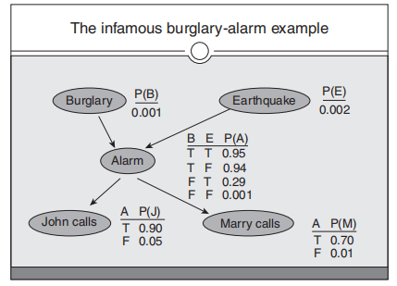
Bayesians belief network
12.1 Uncertainty
12.2 Basic probability theorem
12.3 Baye’s theorem
12.4 Bayesians belief network
12.5 Temporal model
12.6 Marvok Decision Process
12.7 MDP Formulation
12.8 Partially observable MDP
Copyright © 2019 by Wiley India Pvt. Ltd., 4436/7, Ansari Road, Daryaganj, New Delhi-110002

Slide 41

Bayesians belief network
12.1 Uncertainty
12.2 Basic probability theorem
12.3 Baye’s theorem
12.4 Bayesians belief network
12.5 Temporal model
12.6 Marvok Decision Process
12.7 MDP Formulation
12.8 Partially observable MDP
Semantics of Bayesians network
1. Representing Full-Joint Distribution
Conditional Independence Relations in Bayesian Network
The preceding analysis depicts that the conditional independence of a node and its predecessors is expressed by the belief network. Given, its parents uses this independence to design a construction method for the network. In case of designing inference algorithms,
Copyright © 2019 by Wiley India Pvt. Ltd., 4436/7, Ansari Road, Daryaganj, New Delhi-110002

Slide 42
Bayesians belief network
12.1 Uncertainty
12.2 Basic probability theorem
12.3 Baye’s theorem
12.4 Bayesians belief network
12.5 Temporal model
12.6 Marvok Decision Process
12.7 MDP Formulation
12.8 Partially observable MDP
However, it is required to be aware of whether more general conditional independences hold. If a network is given, is it possible to “read off” whether a set of node X is independent of another set Y, given a set of evidence nodes E₁. The answer to this is yes, and the method is given by the notion of direct dependent separation or d-separation.
Copyright © 2019 by Wiley India Pvt. Ltd., 4436/7, Ansari Road, Daryaganj, New Delhi-110002

Slide 43
Bayesians belief network
12.1 Uncertainty
12.2 Basic probability theorem
12.3 Baye’s theorem
12.4 Bayesians belief network
12.5 Temporal model
12.6 Marvok Decision Process
12.7 MDP Formulation
12.8 Partially observable MDP
If all the undirected path from node in X to a node in Y is d-separated by E, then X and Y are independent conditionally given E. The definition of d-separation seems to be complicated. It is required to have an appeal to it several times in constructing our influence algorithms. Once this is done, however, the process of constructing and using belief networks does not engage any uses of d-separation. A set of nodes E d-separates two sets of nodes X and Y if every undirected path from node in X to node in Y blocked given E. A path is blocked given a set of nodes E if there is a node Z on the path for which one of the following three conditions hold:
Z is in E and Z has one arrow on the path leading in and one arrow out.
Z is in E and Z has both arrows leading out.
Neither Z nor any descendent of Z is in E, and both the path arrows lead into Z.
Copyright © 2019 by Wiley India Pvt. Ltd., 4436/7, Ansari Road, Daryaganj, New Delhi-110002

Slide 44
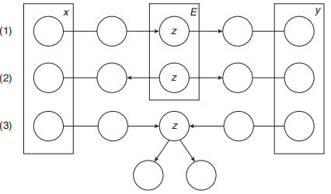
Bayesians belief network
12.1 Uncertainty
12.2 Basic probability theorem
12.3 Baye’s theorem
12.4 Bayesians belief network
12.5 Temporal model
12.6 Marvok Decision Process
12.7 MDP Formulation
12.8 Partially observable MDP
Copyright © 2019 by Wiley India Pvt. Ltd., 4436/7, Ansari Road, Daryaganj, New Delhi-110002

Slide 45
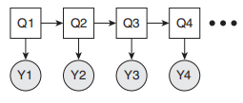
Temporal model
12.1 Uncertainty
12.2 Basic probability theorem
12.3 Baye’s theorem
12.4 Bayesians belief network
12.5 Temporal model
12.6 Marvok Decision Process
12.7 MDP Formulation
12.8 Partially observable MDP
Dynamic Bayesian Networks (DBNs) are directed graphical models of stochastic processes. They gener-alise hidden Markov models (HMMs) and linear dynamical systems (LDSs) by representing the hidden (and observed) state in terms of state variables, which can have complex interdependencies. The graphical structure provides an easy way to specify these conditional independencies, and hence to provide a compact parameterization of the model.
Types of temporal model:
Hidden Marvok models: The simplest kind of DBN is an HMM, which has one discrete hidden node and one discrete or continuous observed node per slice. We illustrate this as follows. As before, circles denote continuous nodes, squares denote discrete nodes, clear means hidden, and shaded means observed.
Copyright © 2019 by Wiley India Pvt. Ltd., 4436/7, Ansari Road, Daryaganj, New Delhi-110002

Slide 46
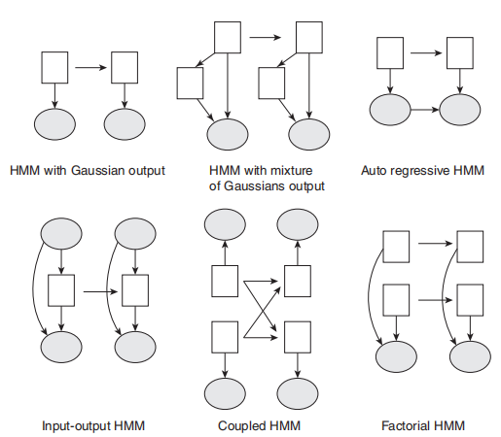
Temporal model
12.1 Uncertainty
12.2 Basic probability theorem
12.3 Baye’s theorem
12.4 Bayesians belief network
12.5 Temporal model
12.6 Marvok Decision Process
12.7 MDP Formulation
12.8 Partially observable MDP
Some common variants on HMMs are shown as follows:
Copyright © 2019 by Wiley India Pvt. Ltd., 4436/7, Ansari Road, Daryaganj, New Delhi-110002

Slide 47

Andrei Markov
12.1 Uncertainty
12.2 Basic probability theorem
12.3 Baye’s theorem
12.4 Bayesians belief network
12.5 Temporal model
12.6 Marvok Decision Process
12.7 MDP Formulation
12.8 Partially observable MDP
Russian statistician (1856 – 1922)
Studied temporal probability models
Markov assumption
State_{t} depends only on a bounded subset of State_{0:t-1}
First-order Markov process
P(State_{t} | State_{0:t-1}) = P(State_{t} | State_{t-1})
Second-order Markov process
P(State_{t} | State_{0:t-1}) = P(State_{t} | State_{t-2:t-1})
Copyright © 2019 by Wiley India Pvt. Ltd., 4436/7, Ansari Road, Daryaganj, New Delhi-110002

Slide 48
Hidden Markov Model (HMM)
12.1 Uncertainty
12.2 Basic probability theorem
12.3 Baye’s theorem
12.4 Bayesians belief network
12.5 Temporal model
12.6 Marvok Decision Process
12.7 MDP Formulation
12.8 Partially observable MDP
Evidence can be observed, but the state is hidden
Three components
Priors (initial state probabilities)
State transition model
Evidence observation model
Changes are assumed to be caused by a stationary process
The transition and observation models do not change
Copyright © 2019 by Wiley India Pvt. Ltd., 4436/7, Ansari Road, Daryaganj, New Delhi-110002

Slide 49
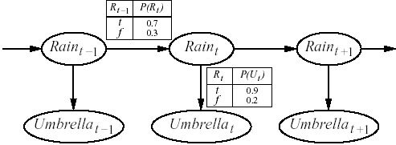
Simple HMM
12.1 Uncertainty
12.2 Basic probability theorem
12.3 Baye’s theorem
12.4 Bayesians belief network
12.5 Temporal model
12.6 Marvok Decision Process
12.7 MDP Formulation
12.8 Partially observable MDP
Security guard resides in underground facility (with no way to see if it is raining)
Wants to determine the probability of rain given whether the director brings an umbrella
P(Rain₀ = t) = 0.50
Copyright © 2019 by Wiley India Pvt. Ltd., 4436/7, Ansari Road, Daryaganj, New Delhi-110002

Slide 50
What can you do with an HMM?
12.1 Uncertainty
12.2 Basic probability theorem
12.3 Baye’s theorem
12.4 Bayesians belief network
12.5 Temporal model
12.6 Marvok Decision Process
12.7 MDP Formulation
12.8 Partially observable MDP
Filtering
P(State_{t} | Evidence_{1:t})
Prediction
P(State_{t+k} | Evidence_{1:t})
Smoothing
P(State_{k} | Evidence_{1:t})
Most likely explanation
argmax_{State1:t} P(State_{1:t} | Evidence_{1:t})
Copyright © 2019 by Wiley India Pvt. Ltd., 4436/7, Ansari Road, Daryaganj, New Delhi-110002

Slide 51
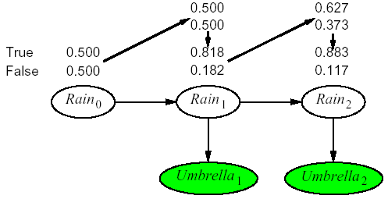
Filtering (the forward algorithm)
12.1 Uncertainty
12.2 Basic probability theorem
12.3 Baye’s theorem
12.4 Bayesians belief network
12.5 Temporal model
12.6 Marvok Decision Process
12.7 MDP Formulation
12.8 Partially observable MDP
P(Rain₁ = t)
= Σ_{Rain0} P(Rain₁ = t | Rain₀) P(Rain₀)
=0.70 * 0.50 + 0.30 * 0.50 = 0.50
P(Rain₁ = t | Umbrella₁ = t)
= α P(Umbrella₁ = t | Rain₁ = t) P(Rain₁ = t)
= α * 0.90 * 0.50 = α *0.45 ≈ 0.818
P(Rain₂ = t | Umbrella₁ = t)
= Σ_{Rain1} P(Rain₂ = t | Rain₁) P(Rain₁ | Umbrella₁ = t)
= 0.70 * 0.818 + 0.30 * 0.182 ≈ 0.627
P(Rain₂ = t | Umbrella₁ = t, Umbrella₂ = t)
= α P(Umbrella₂ = t | Rain₂ = t) P(Rain₂ = t | Umbrella₁ = t)
= α * 0.90 * 0.627 ≈ α * 0.564 ≈ 0.883
Copyright © 2019 by Wiley India Pvt. Ltd., 4436/7, Ansari Road, Daryaganj, New Delhi-110002

Slide 52
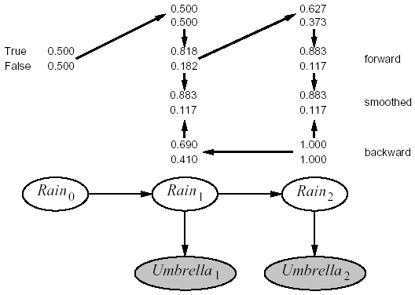
Smoothing (the forward-backward algorithm)
12.1 Uncertainty
12.2 Basic probability theorem
12.3 Baye’s theorem
12.4 Bayesians belief network
12.5 Temporal model
12.6 Marvok Decision Process
12.7 MDP Formulation
12.8 Partially observable MDP
P(Umbrella₂ = t | Rain₁ = t)
= Σ_{Rain2} P(Umbrella₂ = t | Rain₂) P(* | Rain₂) P(Rain₂ | Rain₁ = t)
= 0.9 * 1.0 * 0.7 + 0.2 * 1.0 * 0.3 = 0.69
P(Rain₁ = t | Umbrella₁ = t, Umbrella₂ = t)
= α * 0.818 * 0.69 ≈ α * 0.56 ≈ 0.883
Copyright © 2019 by Wiley India Pvt. Ltd., 4436/7, Ansari Road, Daryaganj, New Delhi-110002

Slide 53
Most Likely Explanation (the Viterbi algorithm)
12.1 Uncertainty
12.2 Basic probability theorem
12.3 Baye’s theorem
12.4 Bayesians belief network
12.5 Temporal model
12.6 Marvok Decision Process
12.7 MDP Formulation
12.8 Partially observable MDP
P(Rain₁ = t, Rain₂ = t | Umbrella₁ = t, Umbrella₂ = t)
= P(Umbrella₁ = t | Rain₁ = t)
* P(Rain₂ = t | Rain₁ = t)
* P (Umbrella₂ = t | Rain₂ = t)
= 0.818 * 0.70 * 0.90 ≈ 0.515
Copyright © 2019 by Wiley India Pvt. Ltd., 4436/7, Ansari Road, Daryaganj, New Delhi-110002

Slide 54
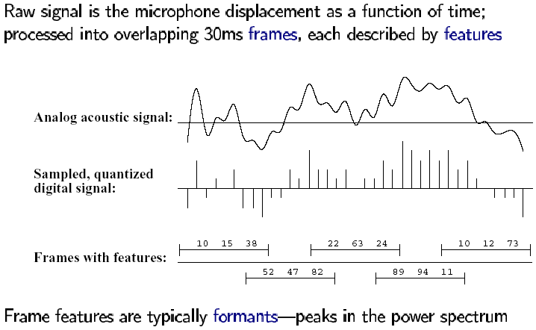
Speech Recognition (signal preprocessing)
12.1 Uncertainty
12.2 Basic probability theorem
12.3 Baye’s theorem
12.4 Bayesians belief network
12.5 Temporal model
12.6 Marvok Decision Process
12.7 MDP Formulation
12.8 Partially observable MDP
Copyright © 2019 by Wiley India Pvt. Ltd., 4436/7, Ansari Road, Daryaganj, New Delhi-110002

Slide 55
Speech Recognition (models)
12.1 Uncertainty
12.2 Basic probability theorem
12.3 Baye’s theorem
12.4 Bayesians belief network
12.5 Temporal model
12.6 Marvok Decision Process
12.7 MDP Formulation
12.8 Partially observable MDP
P(Words | Signal) = α P(Signal | Words) P(Words)
Decomposes into an acoustic model and a language model
Ceiling or Sealing
High ceiling or High sealing
A state in a continuous speech HMM may be labeled with a phone, a phone state, and a word
Copyright © 2019 by Wiley India Pvt. Ltd., 4436/7, Ansari Road, Daryaganj, New Delhi-110002

Slide 56
Speech Recognition (phones)
12.1 Uncertainty
12.2 Basic probability theorem
12.3 Baye’s theorem
12.4 Bayesians belief network
12.5 Temporal model
12.6 Marvok Decision Process
12.7 MDP Formulation
12.8 Partially observable MDP
Human languages use a limited repertoire of sounds
Copyright © 2019 by Wiley India Pvt. Ltd., 4436/7, Ansari Road, Daryaganj, New Delhi-110002

Slide 57
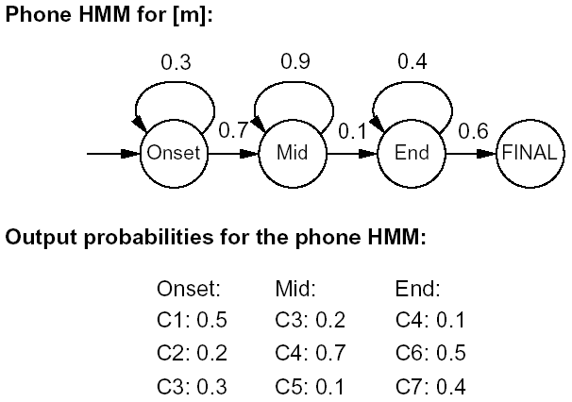
Speech Recognition (phone model)
12.1 Uncertainty
12.2 Basic probability theorem
12.3 Baye’s theorem
12.4 Bayesians belief network
12.5 Temporal model
12.6 Marvok Decision Process
12.7 MDP Formulation
12.8 Partially observable MDP
Acoustic signal for [t]
Silent beginning
Small explosion in the middle
(Usually) Hissing at the end
Copyright © 2019 by Wiley India Pvt. Ltd., 4436/7, Ansari Road, Daryaganj, New Delhi-110002

Slide 58
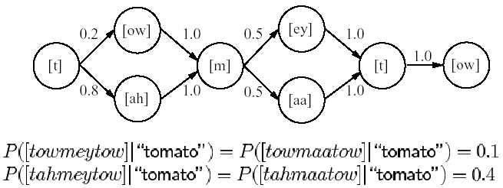
Speech Recognition (pronounciation model)
12.1 Uncertainty
12.2 Basic probability theorem
12.3 Baye’s theorem
12.4 Bayesians belief network
12.5 Temporal model
12.6 Marvok Decision Process
12.7 MDP Formulation
12.8 Partially observable MDP
Coarticulation and dialect variations
Copyright © 2019 by Wiley India Pvt. Ltd., 4436/7, Ansari Road, Daryaganj, New Delhi-110002

Slide 59
Speech Recognition (language model)
12.1 Uncertainty
12.2 Basic probability theorem
12.3 Baye’s theorem
12.4 Bayesians belief network
12.5 Temporal model
12.6 Marvok Decision Process
12.7 MDP Formulation
12.8 Partially observable MDP
Can be as simple as bigrams
P(Word_{i} | Word_{1:i-1}) = P(Word_{i} | Word_{i-1})
Copyright © 2019 by Wiley India Pvt. Ltd., 4436/7, Ansari Road, Daryaganj, New Delhi-110002

Slide 60

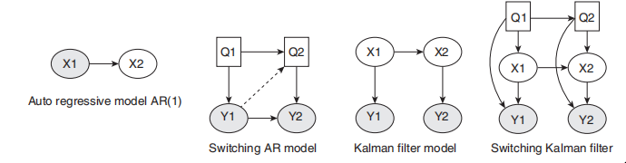
Temporal model
12.1 Uncertainty
12.2 Basic probability theorem
12.3 Baye’s theorem
12.4 Bayesians belief network
12.5 Temporal model
12.6 Marvok Decision Process
12.7 MDP Formulation
12.8 Partially observable MDP
2. Linear dynamical systems and Kalman filters:
An LDS has the same topology as an HMM, but all the nodes are assumed to have linear-Gaussian distributions, that is,
The Kalman filter is a way of doing online filtering in this model. Some simple variants of LDSs are as follows:
Copyright © 2019 by Wiley India Pvt. Ltd., 4436/7, Ansari Road, Daryaganj, New Delhi-110002

Slide 61
Marvok Decision Process
12.1 Uncertainty
12.2 Basic probability theorem
12.3 Baye’s theorem
12.4 Bayesians belief network
12.5 Temporal model
12.6 Marvok Decision Process
12.7 MDP Formulation
12.8 Partially observable MDP
Reinforcement learning is a type of Machine Learning. It allows machines and software agents to automaically determine the ideal behaviour within a specific context in order to maximize its performance. Simple reward feedback is required for the agent to learn its behaviour; which is known as the reinforcement signal.
In the problem, an agent is supposed to decide the best action to select based on his current state. When this step is repeated, the problem is known as a Markov Decision Process.
An MDP model contains:
A set of possible world states S.
A set of Models.
Copyright © 2019 by Wiley India Pvt. Ltd., 4436/7, Ansari Road, Daryaganj, New Delhi-110002

Slide 62
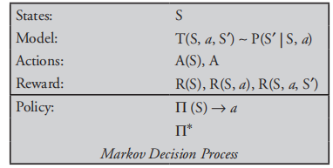
Marvok Decision Process
12.1 Uncertainty
12.2 Basic probability theorem
12.3 Baye’s theorem
12.4 Bayesians belief network
12.5 Temporal model
12.6 Marvok Decision Process
12.7 MDP Formulation
12.8 Partially observable MDP
A set of possible actions A.
A real valued reward function R(s, a).
A policy is a solution to the MDP
What Is a State?
A state is a set of tokens that represent every state that the agent can be in.
Copyright © 2019 by Wiley India Pvt. Ltd., 4436/7, Ansari Road, Daryaganj, New Delhi-110002

Slide 63
Marvok Decision Process
12.1 Uncertainty
12.2 Basic probability theorem
12.3 Baye’s theorem
12.4 Bayesians belief network
12.5 Temporal model
12.6 Marvok Decision Process
12.7 MDP Formulation
12.8 Partially observable MDP
What Is a Model?
A model (sometimes called Transition Model) gives an action’s effect in a state
What Is an Action?
An action A is a set of all possible actions. A(s) defines the set of actions that can be taken being in state S.
What Is a Reward?
A reward is a real-valued reward function. R(s) indicates the reward for simply being in the state S.
What Is a Policy?
A policy is a solution to the MDP. A policy is a mapping from S to a. It indicates the action ‘a’ to be taken while in state S.
Copyright © 2019 by Wiley India Pvt. Ltd., 4436/7, Ansari Road, Daryaganj, New Delhi-110002

Slide 64
MDP Formulation
12.1 Uncertainty
12.2 Basic probability theorem
12.3 Baye’s theorem
12.4 Bayesians belief network
12.5 Temporal model
12.6 Marvok Decision Process
12.7 MDP Formulation
12.8 Partially observable MDP
MDP consists of a tuple of five elements as follows:
S: Set of states. At each time step the state of the environment is an element s S.
A: Set of actions. At each time step the agent choses an action a A to perform.
p(s_{t + 1}
s_t, a_t): State transition model that describes how the environment state changes when the user performs an action a depending on the action a and the current state s.
4. p(r_{t + 1}
s_t, a_t): Reward model that describes the real-valued reward value that the agent receives from the environment after performing an action. In MDP the reward value depends on the current state and the action performed.
Copyright © 2019 by Wiley India Pvt. Ltd., 4436/7, Ansari Road, Daryaganj, New Delhi-110002

Slide 65
MDP Formulation
12.1 Uncertainty
12.2 Basic probability theorem
12.3 Baye’s theorem
12.4 Bayesians belief network
12.5 Temporal model
12.6 Marvok Decision Process
12.7 MDP Formulation
12.8 Partially observable MDP
5. f : Discount factor that controls the importance of future rewards. We will describe it in more details later.
Copyright © 2019 by Wiley India Pvt. Ltd., 4436/7, Ansari Road, Daryaganj, New Delhi-110002

Slide 66
Partially observable MDP
12.1 Uncertainty
12.2 Basic probability theorem
12.3 Baye’s theorem
12.4 Bayesians belief network
12.5 Temporal model
12.6 Marvok Decision Process
12.7 MDP Formulation
12.8 Partially observable MDP
A partially observable Markov decision process (POMDP) is a combination of an MDP and a hidden Markov model. Instead of assuming that the state is observable, we assume that there are some partial and/ or noisy observations of the state that the agent gets to observe before it has to act.
A POMDP consists of the following:
S, a set of states of the world.
A, a set of actions.
O, a set of possible observations.
P(S₀), which gives the probability distribution of the starting state.
P(S′|S, A), which specifies the dynamics – the probability of getting to state S′ by doing action A from state S.
Copyright © 2019 by Wiley India Pvt. Ltd., 4436/7, Ansari Road, Daryaganj, New Delhi-110002

Slide 67
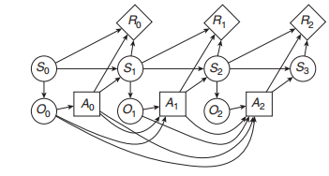
Partially observable MDP
12.1 Uncertainty
12.2 Basic probability theorem
12.3 Baye’s theorem
12.4 Bayesians belief network
12.5 Temporal model
12.6 Marvok Decision Process
12.7 MDP Formulation
12.8 Partially observable MDP
R(S, A, S′), which gives the expected reward of starting in state S, doing action A, and transitioning to state S′and
P(O|S), which gives the probability of observing O given the state is S.
Copyright © 2019 by Wiley India Pvt. Ltd., 4436/7, Ansari Road, Daryaganj, New Delhi-110002

Slide 68

Dr. Nilakshi Jain Email ID : nilakshijain1986@gmail.com
Thank you

